Slide 1
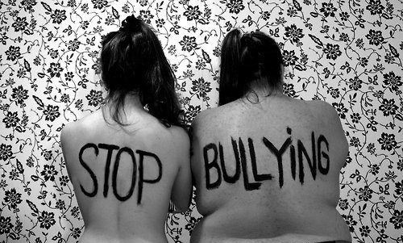

Lays Rodrigues – n° 18 – 1° ano C
Raissa Marcato – n° 28 – 1° ano C

Slide 2

Real Report of Bullying
“Since I was about 9, (I'm 12 now) I have been bullied at school. People call me fat and ugly. They laugh at me, threaten to beat me. Every time I told a teacher, they told me to go to the guidance counselor. When I go, she tells me to ignore them. Anyone who's been bullied, knows that's quite hard. Just recently in 6th grade, it got more serious. I started thinking about suicide and cutting. My friends told all our teachers, and finally they did something. Bullying has decreased for me. So, the point is, don't be afraid to tell someone. Friends, teachers, neighbors, parents, siblings, anyone. They WILL help. Just tell them. It'll work eventually.” - Anonymous

Slide 3
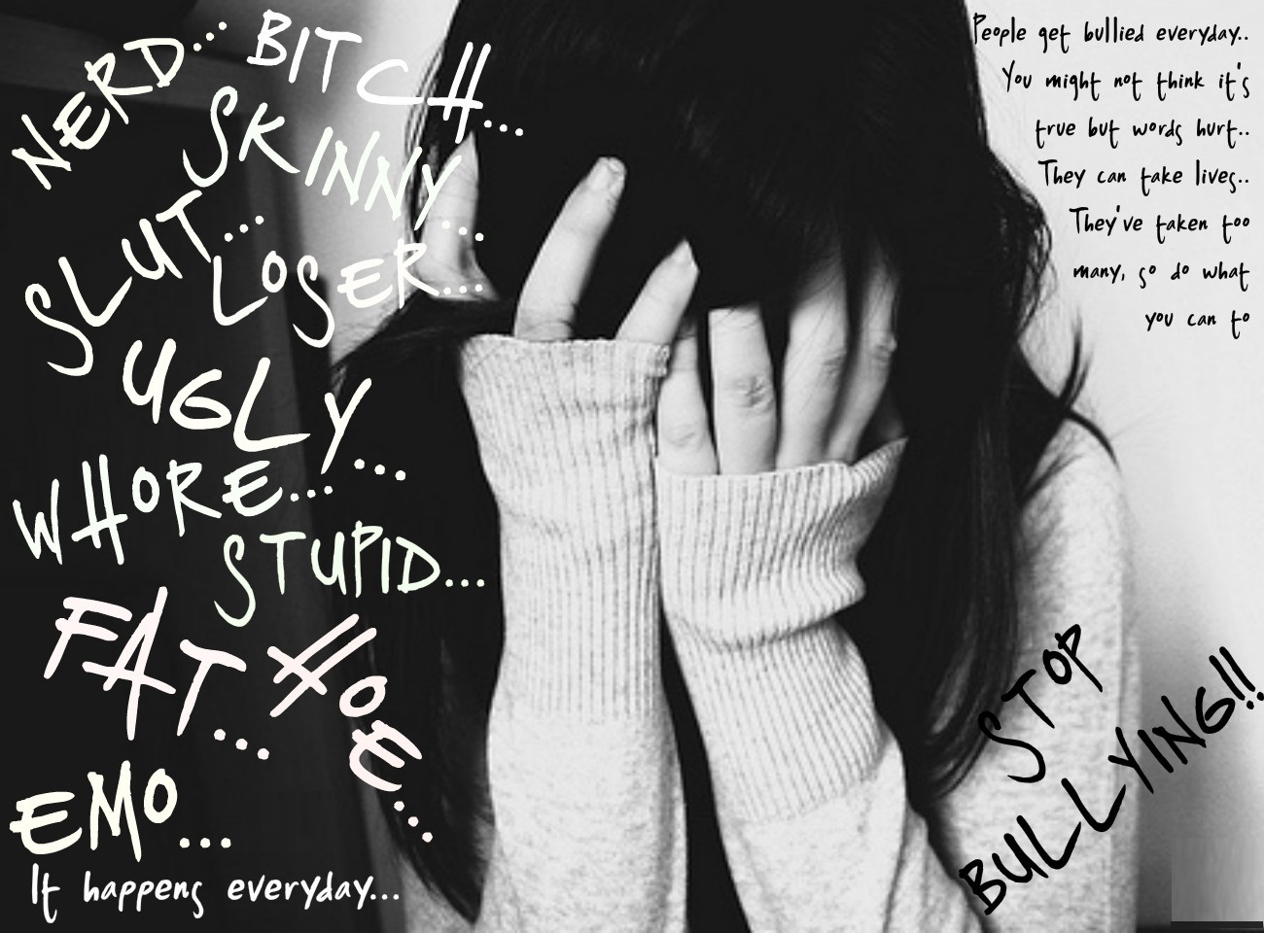

Slide 4


Demi Lovato’s Story

Slide 5


