Slide 1
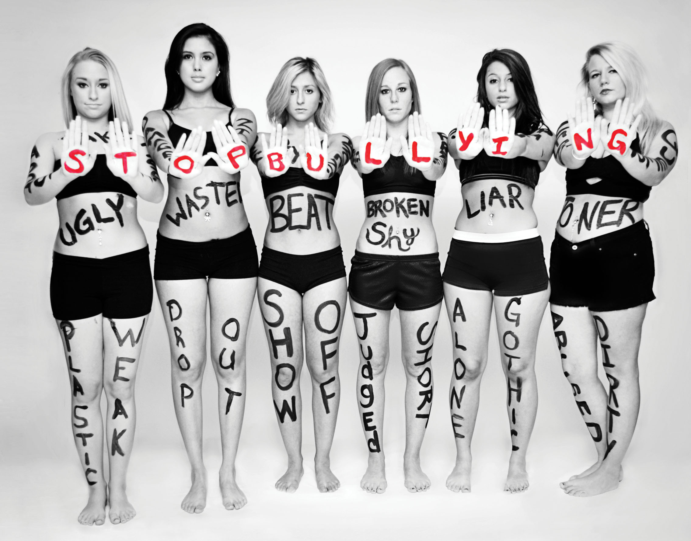
Bullying
Ana Carolina nº 02
Maria Luisa nº20

Slide 2
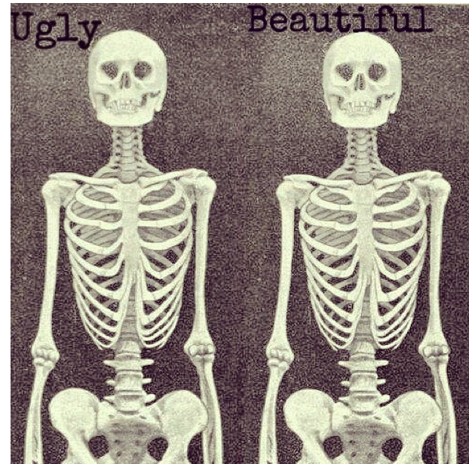
5 types of bullying
Physical
Verbal
Sexual
Emotional
Cyberbullying

Slide 3
One type of cyberbullying
Amanda was 12 when it all started. She was in a chat room with friends, meeting and chatting with other users. She received many compliments from the boys and was induced to show parts of her body. A year later, a boy who was in chat contacted by Facebook said to Amanda that if she didn´t make a show for him, he would show the photos to her friends and family.
He came to haunt her in her hme, in your school and where he spent the holidays. The photos were sent to everyone and then Amanda started getting sick: she suffered from anxiety, depression and panic. And so began using drugs and alcohol. A year passed and he created a Facebook page where the profile picture were her breasts. Amanda made ​​a video in which she told her story, said she "cried all night, I lost all my friends and respect them." She suffered with curses, judgments and suffered even more because I can not get those pictures from the internet. Amanda started to cut herself. She changed school, until, after a month, she met an older boy. He said he was enjoying it, even having a girlfriend. She was deceived and became involved with the boy. The boy's girlfriend joined with 15 girls and humiliated and Amanda ended up suffering physical assaults.
"Some people filmed everything. I was completely alone and left on the floor’’, "she said in her video testimony”.
Amanda came home and tried to kill herself by taking bleach. After being hospitalized and returning home she began to receive messages. Amanda moved to her mother's house. "I know it was wrong, but why they keep chasing me? [...] Every day I ask myself why am I still here? "The girl wondered.
Amanda also overdosed on anti-depressants ingest drugs. A week ago, the girl's body was found. She had hanged herself.

Slide 4


